Slide 1
A gentle introduction to graph neural networks
Alex Ganose
Department of Chemistry
Imperial College London
a.ganose@imperial.ac.uk
website: virtualatoms.org
Notes:
For problem:
- First play around with the data (e.g., structure to edges)
- Get them to write cgcnn (given the convolutions)
- Apply CGCNN to a dataset
- Examine the predictions and also the note embeddings -> could plot s, p, d block with t-sne?
Mention that for MD simulations, every time you want to make a prediction, you need to reconstruct the graph, so this needs to be fast.
Add dates of papers to show how quickly

Slide 2
What is a graph?
Node / vertex
Edge
Graphs encode relations between entities

Slide 3
What is a graph?
Node / vertex
Edge
Edges can be directed

Slide 4
What is a graph?
Node embedding
Edge embedding
Information is stored in each piece

Slide 5
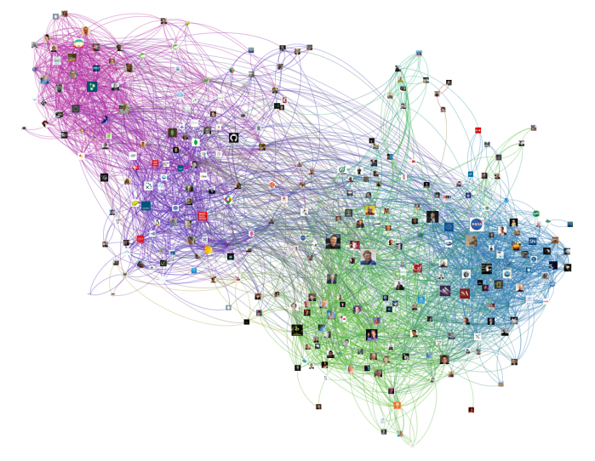
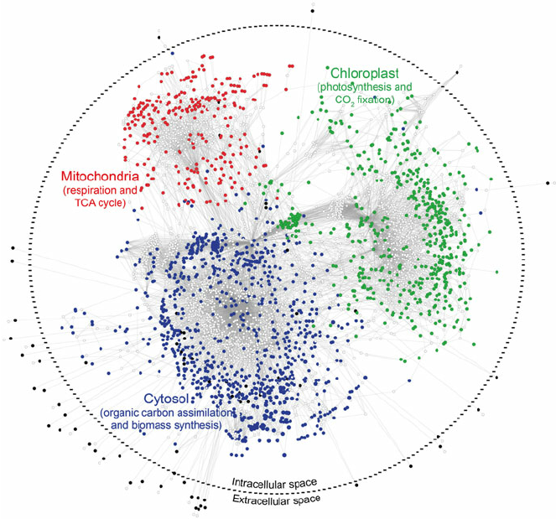
Where do we find graphs
Social networks
> 1B nodes > 10B edges
Biological systems
Clamydomonas reinhardtii
Notes:
Genome scale metabolic network of Clamydomonas reinhardtii The big circle formed by a slashed line represent the boundary of cellular metabolism. Intracellular blue nodes represent metabolites occurring in
black nodes on the “extracellular space” represent metabolites able to be assimilated and/or secreted from the growth medium, white small nodes represent metabolic reactions, grey edges connect metabolic compounds with reactions;

Slide 6
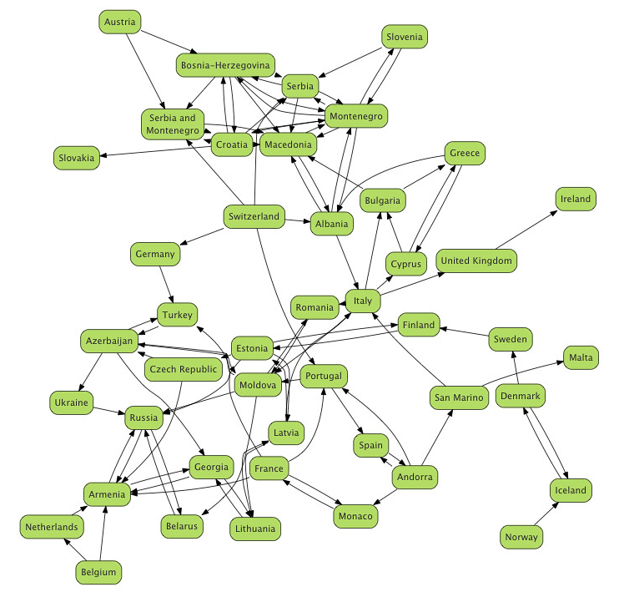
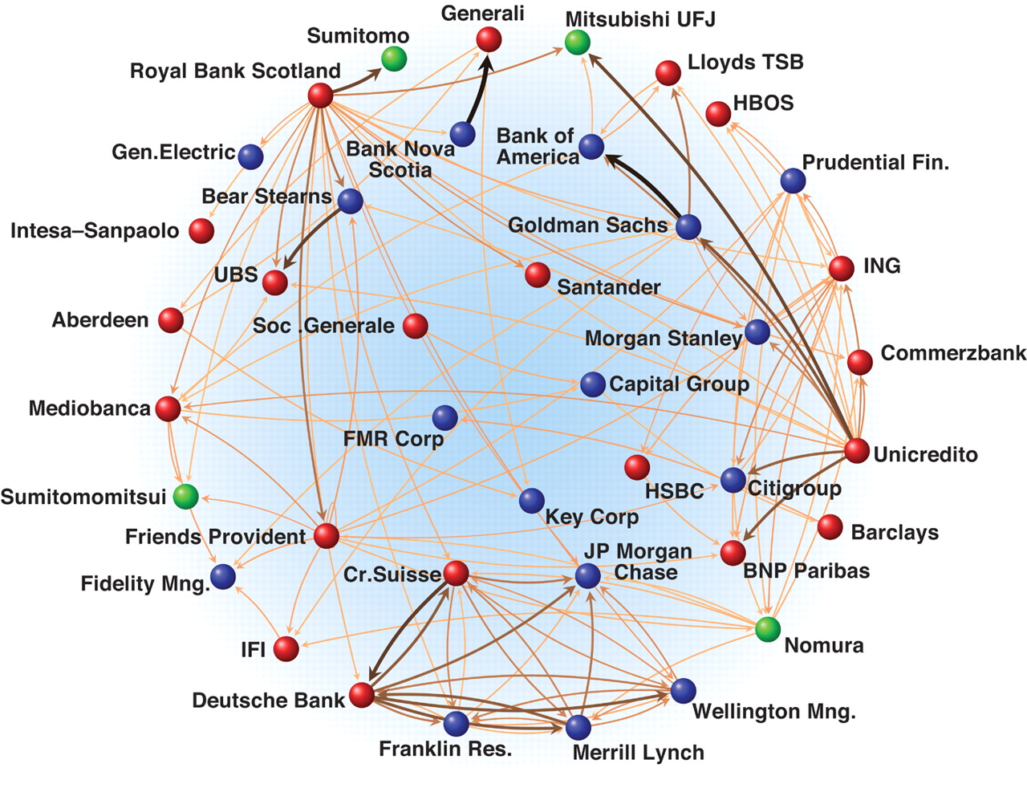
Where do we find graphs
Eurovision
Economics
Notes:
Economics: https://www.science.org/doi/10.1126/science.1173644
A sample of the international financial network, where the nodes represent major financialinstitutions and the links are both directed and weighted and represent the strongest existing relationsamong them.

Slide 7
An image is a graph with regular structure
 | 0-0 | 1-0 | 2-0 | 3-0 | 4-0 | 0-1 | 1-1 | 2-1 | 3-1 | 4-1 | 0-2 | 1-2 | 2-2 | 3-2 | 4-2 | 0-3 | 1-3 | 2-3 | 3-3 | 4-3 | 0-4 | 1-4 | 2-4 | 3-4 | 4-4
0-0
1-0
2-0
3-0
4-0
0-1
1-1
2-1
3-1
4-1
0-2
1-2
2-2
3-2
4-2
0-3
1-3
2-3
3-3
4-3
0-4
1-4
2-4
3-4
4-4
0-0
1-0
2-0
3-0
4-0
0-0
1-0
2-0
3-0
4-0
0-1
1-1
2-1
3-1
4-1
0-1
1-1
2-1
3-1
4-1
0-2
1-2
2-2
3-2
4-2
0-2
1-2
2-2
3-2
4-2
0-3
1-3
2-3
3-3
4-3
0-3
1-3
2-3
3-3
4-3
0-4
1-4
2-4
3-4
4-4
0-4
1-4
2-4
3-4
4-4
Image pixels
Graph
Adjacency matrix
Notes:
We can also use an adjacency matrix to represent the graph

Slide 8
A sentence can be viewed as a directed graph
Graphs
are
all
around
us
 | Graphs | are | all | around | us
Graphs
are
all
around
us
Notes:
Discuss directionality and why the graph isn’t symmetric

Slide 9
Graphs are a natural representation in chemistry
Molecules
Crystals
Notes:
Economics: https://www.science.org/doi/10.1126/science.1173644

Slide 10
All graphs are not alike
The size and connectivity of graphs can vary enormously
Dataset | Graphs | Nodes | Edges
Fully con. | 1 | 5 | 20
Sparse | 2 | <4 | <3
Wikipedia | 1 | 12M | 378M
qm9 | 134k | <9 | <26
Cora | 1 | 23k | 91k
Fully connected
Sparse
Notes:
Economics: https://www.science.org/doi/10.1126/science.1173644

Slide 11
The types of problems tackled with graphs
Graph level
e.g. total energy of a molecule
Node level
e.g. oxidation state of an atom
Edge level
e.g. strength of a bond
Notes:
Graph level
A single prediction for the total graph
Node level
Prediction about the nature of entities
Edge level
Prediction about relations between entities

Slide 12
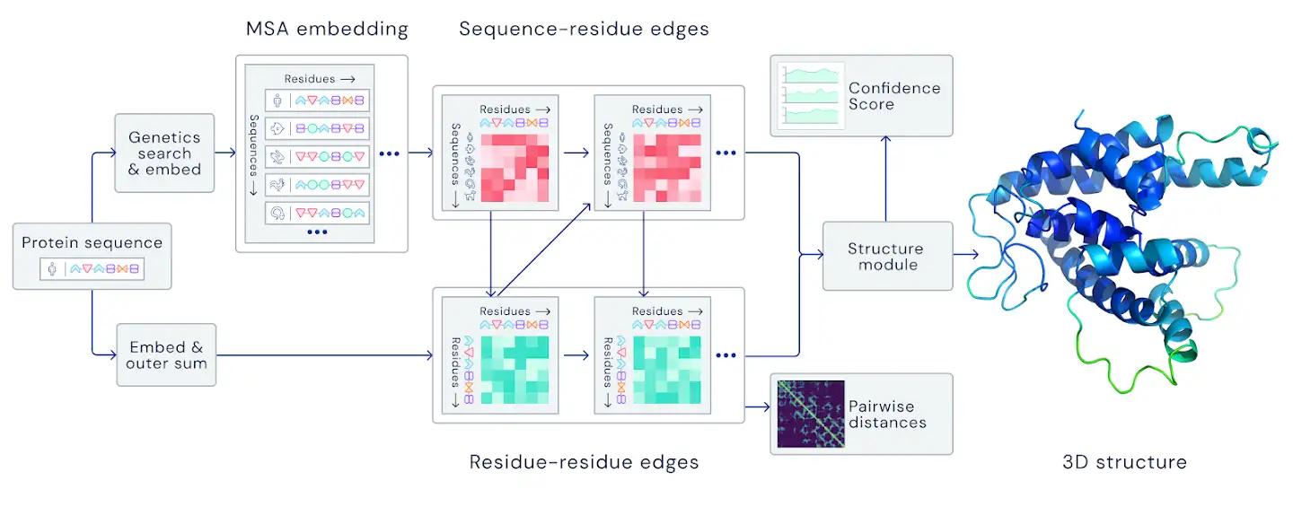
Graph networks enabled Alpha Fold (node level)
Protein as a graph with amino acids (nodes) linked by edges
Used to calculate interactions between parts of the protein
Notes:
Key ingredient was representing protein structure as a graph
Can be used to calculate interactions between parts of the protein and update the positions to find minimum energy structures

Slide 13
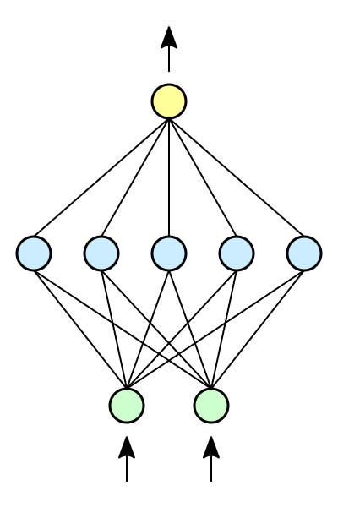
Deep learning with graphs
Include adjacency matrix as features in a standard neural network
 | 0 | 1 | 2 | 3 | 4
0
1
2
3
4
 | 0 | 1 | 1 | 1 | 0
 | 1 | 0 | 1 | 1 | 0
 | 1 | 1 | 0 | 0 | 1
 | 1 | 1 | 0 | 0 | 1
 | 0 | 0 | 1 | 1 | 0
2
0
1
4
3
Issues: fixed size and sensitive to the order of nodes

Slide 14

Deep learning with graphs
A convolutional neural network (CNN) filter transforms and combines information from neighbouring pixels in an image
0 | –1 | 0
–1 | 4 | –1
0 | –1 | 0
Convolution filter
learned during training to extract higher level features e.g., edges

Slide 15
Convolutions on graphs
Images can be seen as a regular graph; can we extend the concept of convolutions?
Convolution from neighbours
to central node

Slide 16
Convolutions on graphs
By iterating over the entire graph each node receives information from its neighbours

Slide 17


Where do neural networks come in?
Neural networks are used to decide:
Σ
Message
What get passed from one node to another
Pooling / Aggregation
How messages from all neighbours are combined
Update
How the node is updated given the pooled message

Slide 18
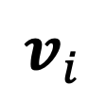
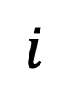
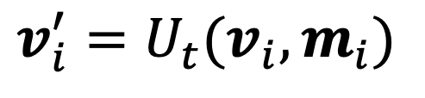
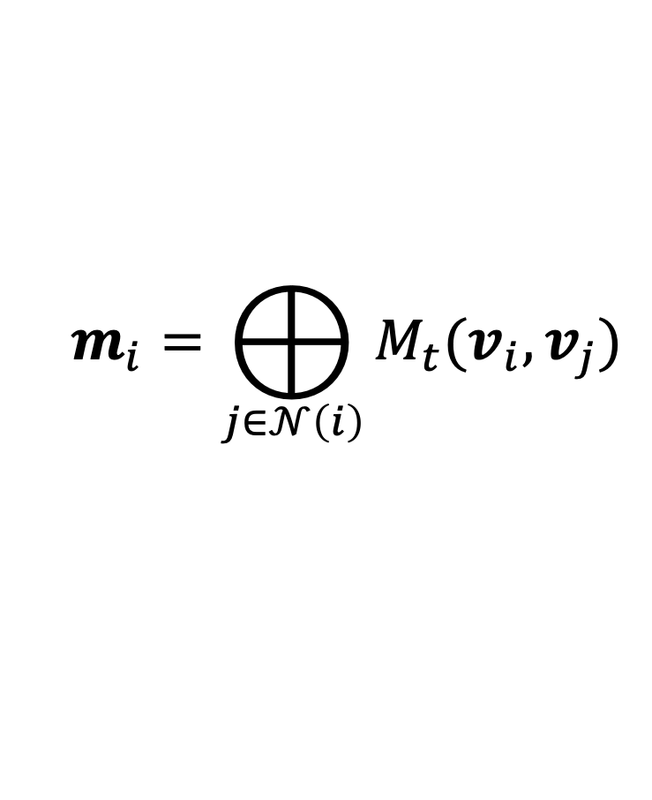
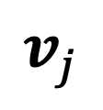
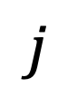
Components of a convolutional graph network
Message function
$$v_{j}$$
$$m_{i}=⨁_{j∈𝒩\left(i\right)}{M_{t}(v_{i},v_{j})}$$
$$j$$
$$v_{i}$$
$$i$$
Pooling function
$$v_{i}^{′}=U_{t}(v_{i},m_{i})$$
Update function

Slide 19
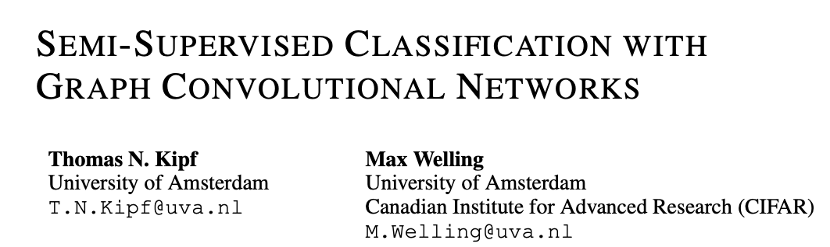
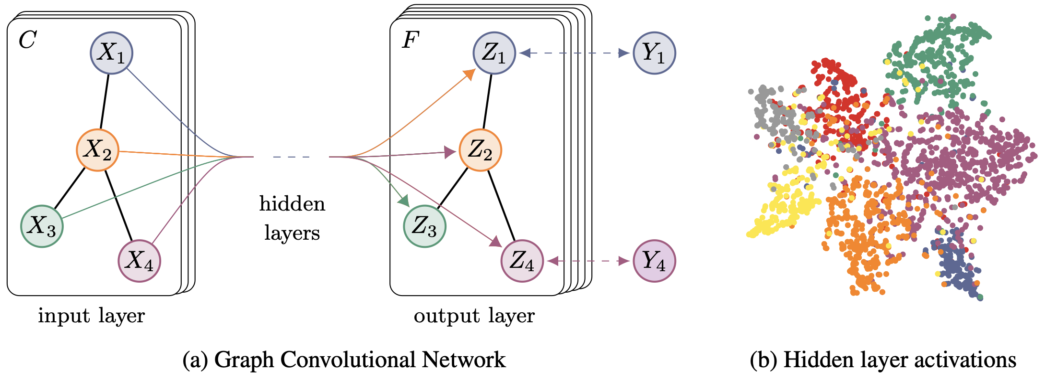
Convolutional graph networks introduced in 2017

Slide 20
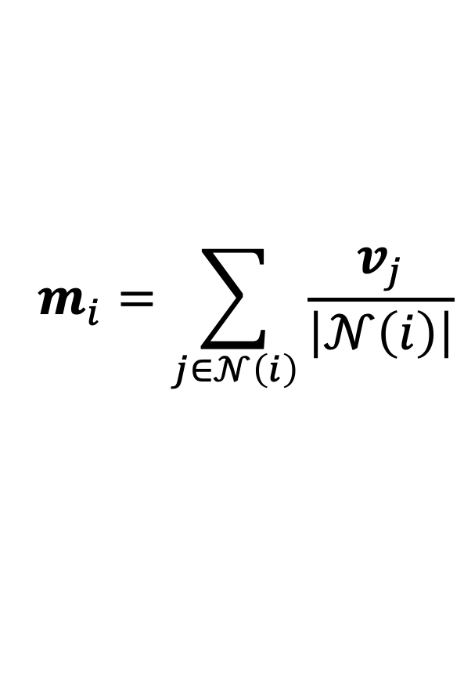
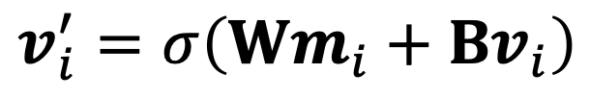
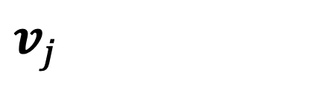
Implementation of neural network functions
Message function: (no processing)
$$v_{j}$$
$$m_{i}=\sum_{j∈𝒩\left(i\right)}{\frac{v_{j}}{\left|𝒩\left(i\right)\right|}}$$
Pooling function: (normalised sum)
num neighbours
Update function: (MLP)
$$v_{i}^{′}=σ\left(Wm_{i}+Bv_{i}\right)$$
non-linearity
weights

Slide 21
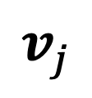
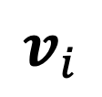
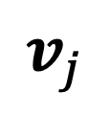
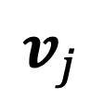
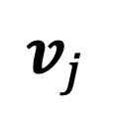
Visual depiction of a graph convolution
$$v_{j}$$
$$v_{j}$$
1. Prepare messages
$$v_{i}$$
$$v_{j}$$
$$v_{j}$$

Slide 22

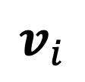
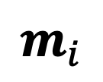
Visual depiction of a graph convolution
1. Prepare messages
2. Pool messages
$$v_{i}$$
$$m_{i}$$
$$v_{j}$$
$$v_{j}$$
$$v_{j}$$
$$v_{j}$$

Slide 23
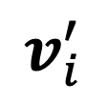
Visual depiction of a graph convolution
1. Prepare messages
2. Pool messages
3. Update embedding
$$v_{i}^{′}$$

Slide 24
Requirements of the pooling function
The pooling function must be invariant to node ordering and the number of nodes
2
Function | Node value
Max | 4
Mean | 3
Sum | 6
?
4
All take a variable number of inputs and provide an output that is the same, no matter the ordering
Notes:
Pooling information from neighboring nodes and edges is a critical step in any reasonably powerful GNN architecture. Because each node has a variable number of neighbors, and because we want a differentiable method of aggregating this information, we want to use a smooth aggregation operation that is invariant to node ordering and the number of nodes provided.
Selecting and designing optimal aggregation operations is an open research topic.
[44]
A desirable property of an aggregation operation is that similar inputs provide similar aggregated outputs, and vice-versa. Some very simple candidate permutation-invariant operations are sum, mean, and max. Summary statistics like variance also work. All of these take a variable number of inputs, and provide an output that is the same, no matter the input ordering. Let’s explore the difference between these operations.
Other methods use LSTM, MLPs, or attention

Slide 25
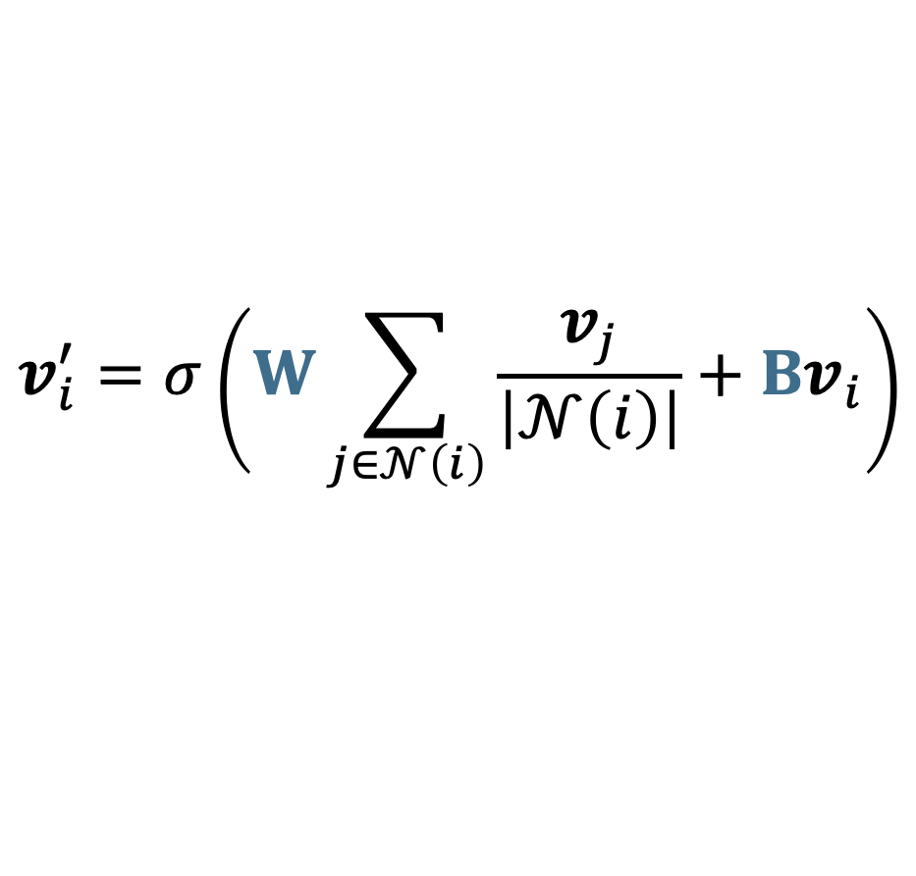
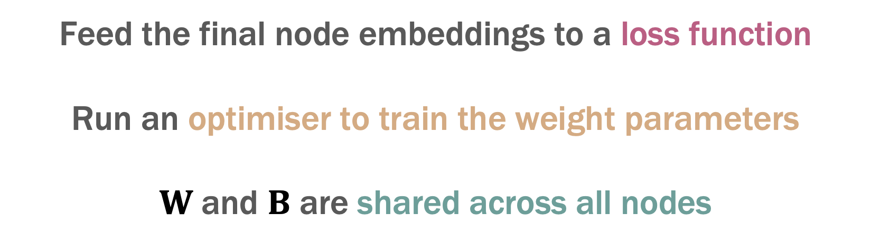
Training convolutional graph neural networks
$$v_{i}^{′}=σ\left(W\sum_{j∈𝒩\left(i\right)}{\frac{v_{j}}{\left|𝒩\left(i\right)\right|}}+Bv_{i}\right)$$
Feed the final node embeddings to a loss function
Run an optimiser to train the weight parameters
$W$and $B$ are shared across all nodes

Slide 26
Inductive capabilities and efficiency
Each node has its own network due to its connectivity
Message, pool, and update functions are shared for all nodes
Can increase number of nodes without increasing the number of parameters
Can introduce new unseen node structures and just plug in the same matrices

Slide 27
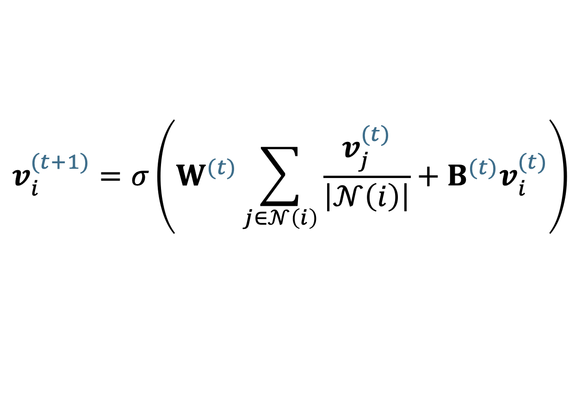
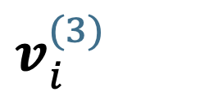
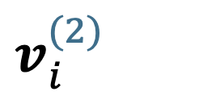
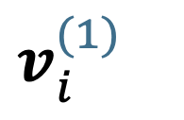
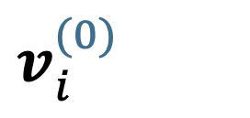
Stacking multiple convolutional layers
Only looked at a single convolution – can we stack multiple layers?
$$v_{i}^{(0)}$$
Convolution
$$v_{i}^{(t+1)}=σ\left(W^{(t)}\sum_{j∈𝒩\left(i\right)}{\frac{v_{j}^{(t)}}{\left|𝒩\left(i\right)\right|}}+B^{(t)}v_{i}^{(t)}\right)$$
$$v_{i}^{(1)}$$
Convolution
$$v_{i}^{(2)}$$
Weights are unique for each layer
Convolution
$$v_{i}^{(3)}$$

Slide 28
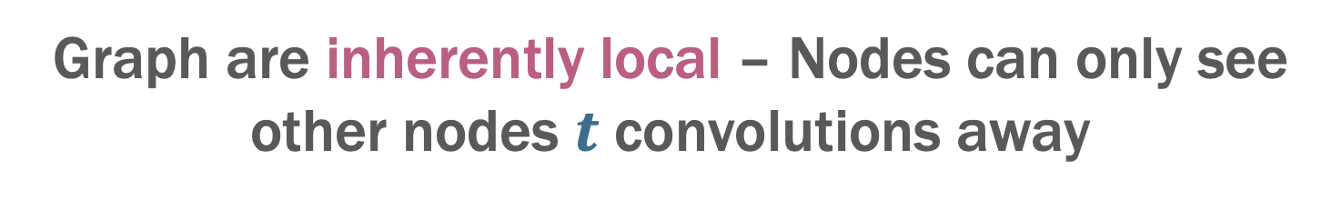
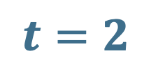
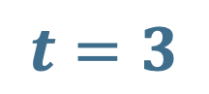
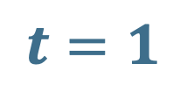
Why multiple convolutions?
Graph are inherently local – Nodes can only see other nodes $t$ convolutions away
$$t=3$$
$$t=1$$
Not seen by node 0
0
1
2
3
4
$$t=2$$
Multiple convolutions increases the “receptive field” of the nodes

Slide 29
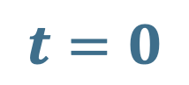
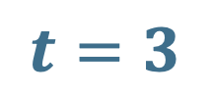
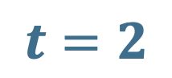

The over smoothing problem
However, too many convolutions causes over smoothing — all node embeddings converge to the same value
$$t=0$$
$$t=1$$
$$t=2$$
$$t=3$$
Notes:
Actually did this colour mixing myself. The pooling was a combination of 2x the central node colour + 1x each of the neigbour colours

Slide 30
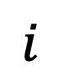
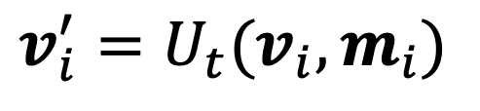
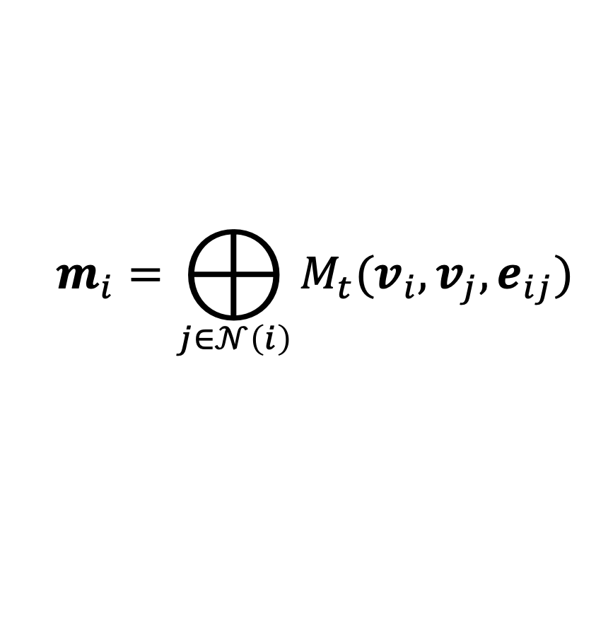
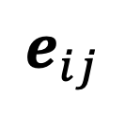
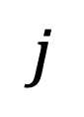
What about edge embeddings
Only considered node updates but graphs have edges too — can we learn something about edges from nodes?
Edge embedding
$$j$$
$$e_{ij}$$
$$m_{i}=⨁_{j∈𝒩\left(i\right)}{M_{t}(v_{i},v_{j},e_{ij})}$$
$$i$$
$$v_{i}^{′}=U_{t}(v_{i},m_{i})$$
Update function stays the same
Notes:
Can say these were termed message passing networks

Slide 31
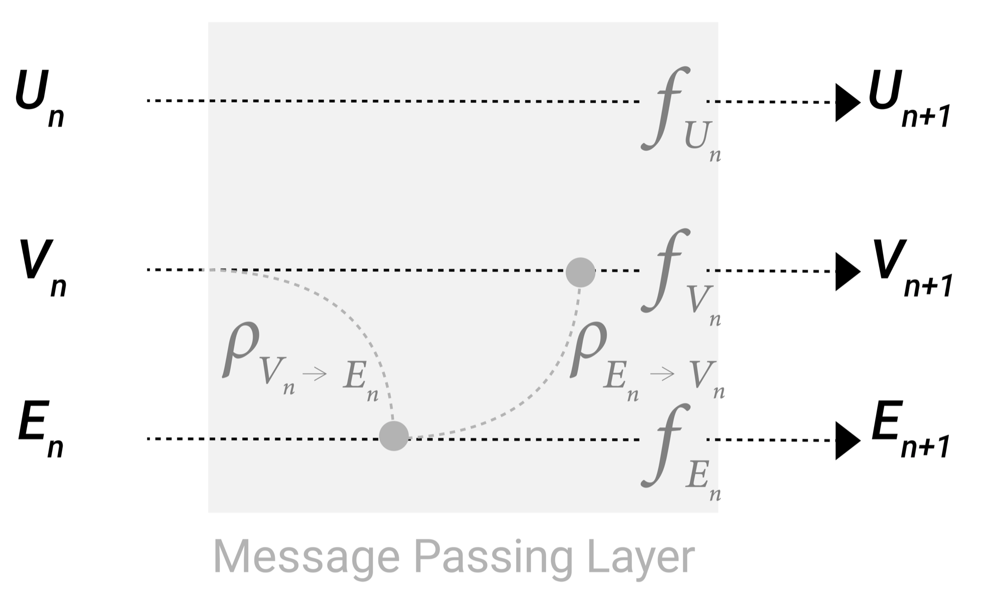
Message passing networks – significant flexibility
Many options for how to treat edges in the pooling function
Edge embeddings may have different dimensionality to node embeddings
An option is to pool all edges and concatenate them at the end
Notes:
We can incorporate the information from neighboring edges in the same way we used neighboring node information earlier, by first pooling the edge information, transforming it with an update function, and storing it.
However, the node and edge information stored in a graph are not necessarily the same size or shape, so it is not immediately clear how to combine them. One way is to learn a linear mapping from the space of edges to the space of nodes, and vice versa. Alternatively, one may concatenate them together before the update function.

Slide 32
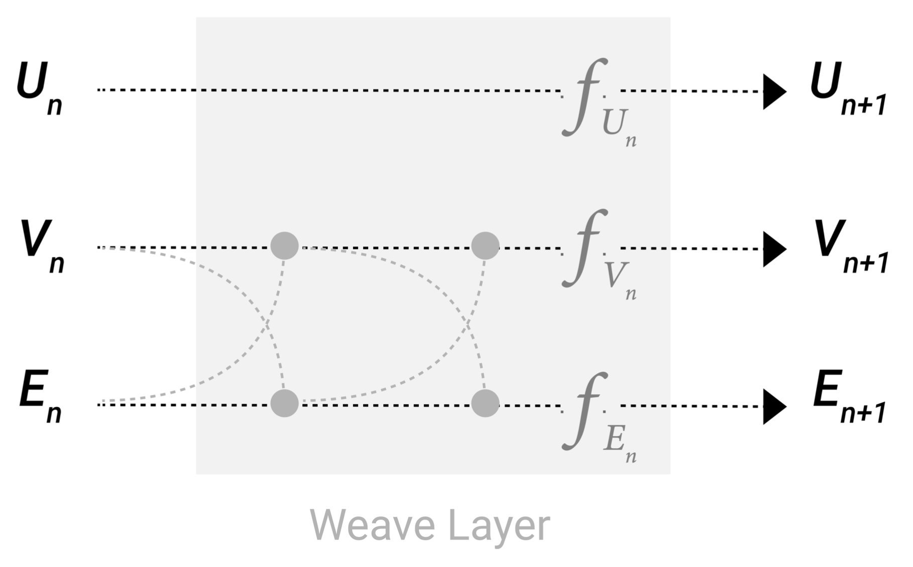
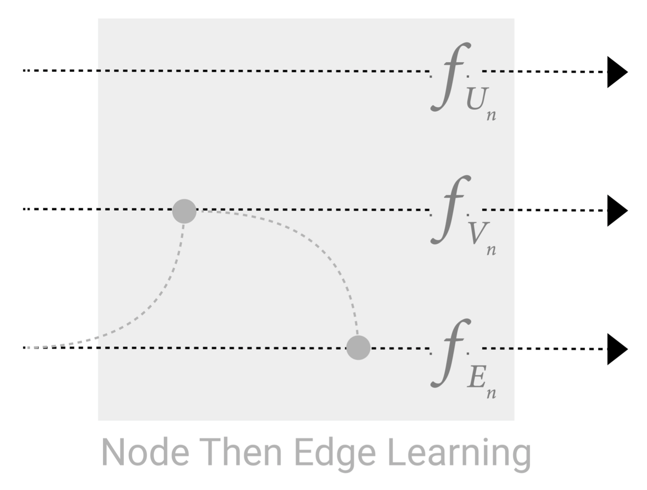
Message passing networks – significant flexibility
Can update nodes before edges or vice versa
Or have a weave design to pass messages back and forth
All flexible design choices in message passing networks
Notes:
Which graph attributes we update and in which order we update them is one design decision when constructing GNNs. We could choose whether to update node embeddings before edge embeddings, or the other way around. This is an open area of research with a variety of solutions– for example we could update in a ‘weave’ fashion[21]
where we have four updated representations that get combined into new node and edge representations: node to node (linear), edge to edge (linear), node to edge (edge layer), edge to node (node layer).

Slide 33
Convolutional graph networks for crystals
Graphs are a natural representation for crystals and but
we have extra design constraints
Networks should be permutation and translation invariant
Properties depend on atom types and coordinates not just connectivity

Slide 34

Constructing the graph from a crystal structure
Include all atoms within a certain cut-off as neighbours
$$r_{cut}$$
Perform the procedure for each atom in the unit cell
Nodes can share multiple edges to the same neighbour due to PBC
Must consider periodic boundaries
Notes:
one atom can be bonded to multiple periodic images of the same atom

Slide 35
Crystal graph convolutional neural networks (CGCNN)
CGCNN was the first time graph convolutions were applied to crystals
Xie and Grossman Phys. Rev. Lett. 120, 145301 (2018)

Slide 36
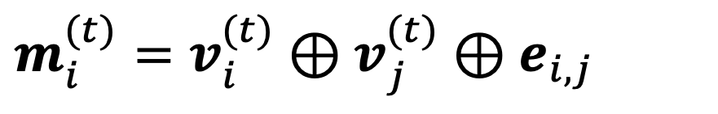
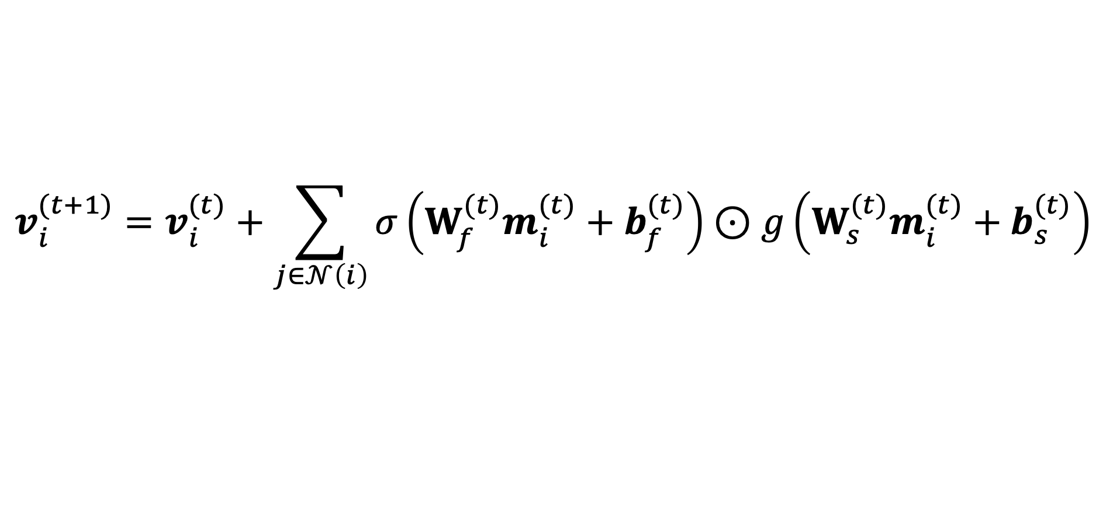
Implementation of CGCNN
Message function:
$${m_{i}^{(t)}=v_{i}^{(t)}⊕v}_{j}^{(t)}⊕e_{i,j}$$
Update function:
$$v_{i}^{(t+1)}=v_{i}^{(t)}+\sum_{j∈𝒩\left(i\right)}{σ\left(W_{f}^{(t)}m_{i}^{(t)}+b_{f}^{(t)}\right)⊙g\left({W_{s}^{(t)}m}_{i}^{(t)}+b_{s}^{(t)}\right)}$$
{
sigmoid
“gate”
softplus

Slide 37
Initialisation — node and edge embeddings
What to do for the initial node and edge embeddings?
Nodes
The element type is one-hot encoded (dimension of 119) and passed through an MLP
Edges
The bond distance is projected onto a Gaussian basis (40 basis functions)

Slide 38
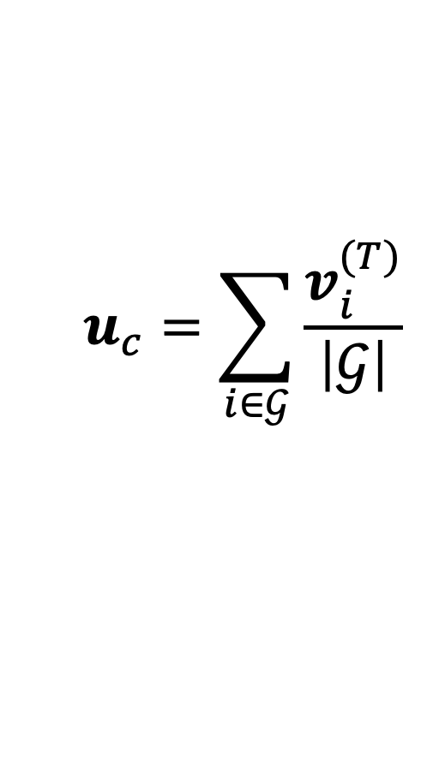

Readout — calculating the final prediction
CGCNN generates graph level predictions, how are these generated from the final node embeddings?
$$u_{c}=\sum_{i∈𝒢}{\frac{v_{i}^{(T)}}{\left|𝒢\right|}}$$
Final pooling of all nodes
num atoms
SLP readout
$E=$ $σ\left({W_{r}u}_{c}{+ b}_{r}\right)$

Slide 39

CGCNN performance
CGCNN shows good accuracy for such a simple model but errors are still too large for reliable science

Slide 40


Advanced message passing networks
CGCNN only uses bond lengths as features. More advanced networks show improved performance
MEGNet
Crystal features and set2set pooling
M3GNet
Bond angles and dihedrals
Notes:
To do: briefly detail some of the new features in modern GNNs for chemistry: E.g., alignn, m3gnet, MACE

Slide 41
Vector and tensor properties — equivariance
Higher dimensionality properties (vectors, tensors) such as force and stress require equivariant models
force
rotate
Forces should transform commensurate with the structure
Notes:
To do: briefly detail some of the new features in modern GNNs for chemistry: E.g., alignn, m3gnet, MACE

Slide 42

Equivariant features
This requires features that transform predictably under rotations
Credit: Tess Smidt, e3nn.org/e3nn-tutorial-mrs-fall-2021
Notes:
To do: briefly detail some of the new features in modern GNNs for chemistry: E.g., alignn, m3gnet, MACE

Slide 43


Equivariant graph models
Higher dimensionality properties (vectors, tensors) such as forces and stresses require equivariant models
e3nn
High-order spherical harmonic basis
Nequip
MLIP tensorial features
Notes:
To do: briefly detail some of the new features in modern GNNs for chemistry: E.g., alignn, m3gnet, MACE

Slide 44

A large number of graph networks exist
Notes:
To do: briefly detail some of the new features in modern GNNs for chemistry: E.g., alignn, m3gnet, MACE

Slide 45

Graph networks and the MatBench dataset
Graph neural networks are widely used for property predictions in chemistry but excel on larger datasets
npj Comput. Mater. 6, 138 (2020)

Slide 46

Uses of graph networks
GNNs take up most of the top spots on the current leader board
Many high-performance MLIPs use graphs (MACE, nequip, allegro)
https://matbench.materialsproject.org

Slide 47
Summary
Many datasets can be represented as graphs.
GNNs work by i) building a graph and ii) propagating information between neighbours using NNs
GNNs are scalable and can generalise well
There are many possibilities for designing GNNs

